Slide 1
The world is moving from 'AI that talks' to 'AI that does’
Enterprises need a Guarded Runtime Reveila: Agentic AI Runtime Fabric moves Unstructured AI to Sovereign Orchestration Era
Notes:
Reveila doesn't compete with OpenAI or Salesforce.
It’s the "Insurance and Guardrails" that allows an enterprise to actually turn on the agents those companies sell.

Slide 2
Most companies trust a single AI. Reveila uses a Check-and-Balance system where different AI providers audit each other. "If ChatGPT is compromised, Gemini catches it. If Gemini is compromised, our Docker physical boundaries stop it. It’s security-in-depth for the AI era."
Notes:
Reveila doesn't compete with OpenAI or Salesforce.
It’s the "Insurance and Guardrails" that allows an enterprise to actually turn on the agents those companies sell.

Slide 3

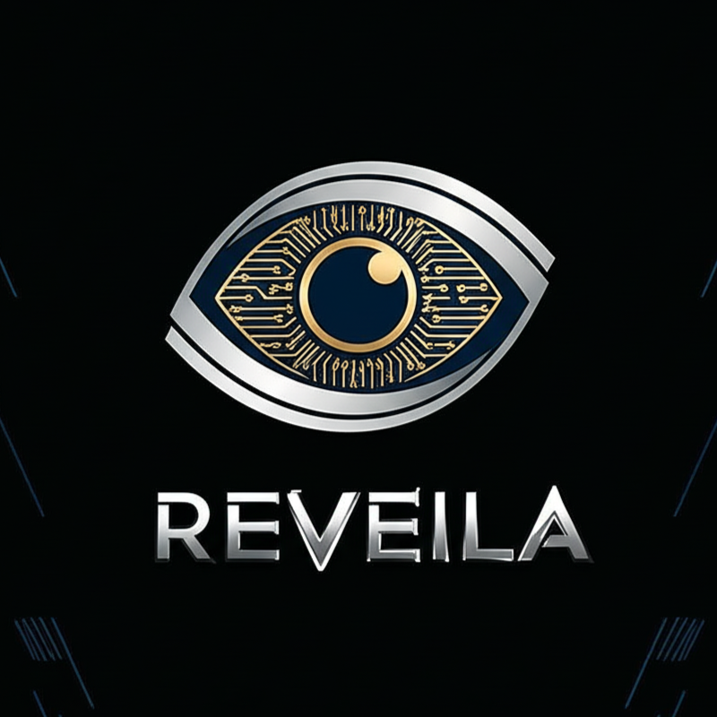
Unstructured AI Is a Liability
Enterprise AI is becoming a multi‑billion‑dollar risk.
Companies want autonomous agents, but “Shadow AI” creates uncontrolled execution.
Agents lack physical boundaries (no guarded runtime).
No forensic trail of why an agent acted (reasoning vs. action gap).
Today’s solutions are mostly chatbots—not an execution fabric.

Slide 4
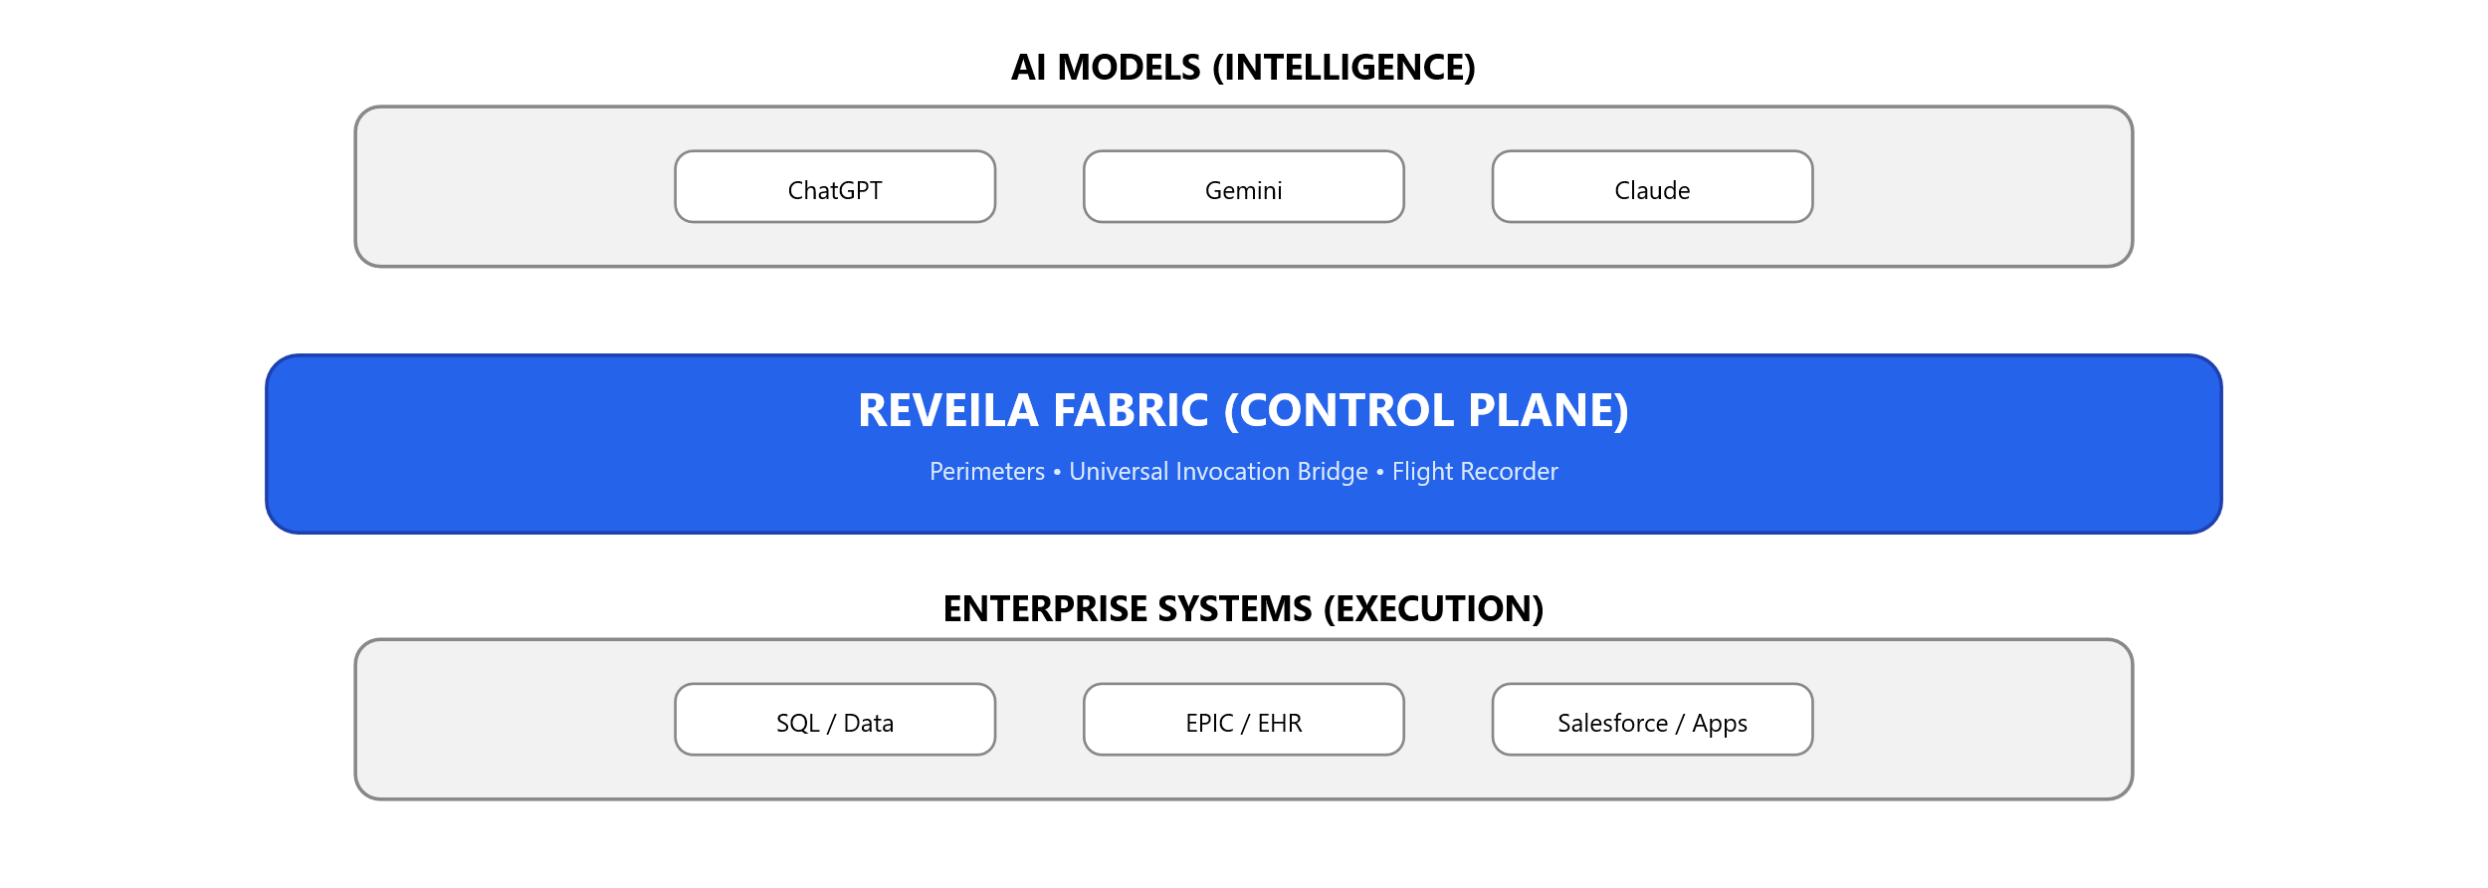
Reveila Is the Agentic Control Plane
An operating system for the Agentic workforce, where AI never touches enterprise systems directly.
Everything flows through Reveila. Agents don’t execute work - the fabric does.
It governs tool calls with perimeters, a universal bridge, and a flight recorder.
Physical isolation (ephemeral sandboxes per tool call)
Metadata‑driven governance (MCP alignment)
Forensic accountability (traceable actions + rationale)
Notes:
AI reasons above. Systems execute below. Nothing crosses without Reveila.
Models are above execution
Systems are below intelligence
Reveila is the only bridge between the two
No direct access
No bypass
No “agent with root credentials”

Slide 5
Dual‑Model Governance (Check & Balance)
Most companies trust a single AI. Reveila does not.
Different providers audit each other: one reasons, one validates intent.
If one model is compromised, the other catches it.
Security‑in‑depth: auditing + runtime boundaries.

Slide 6
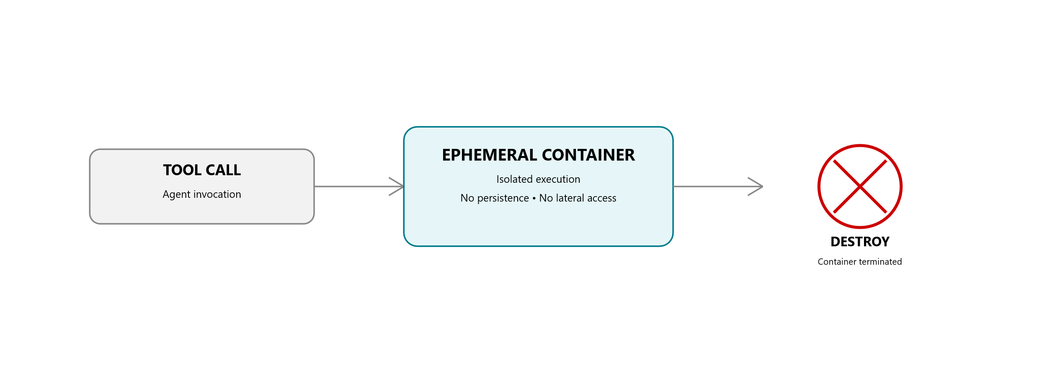
Docker Isolation: A Physical Security Perimeter
Every action runs in a disposable sandbox. When the work is done, the environment ceases to exist.
The perimeter enforces containment: no uncontrolled access to systems.
Ephemeral execution reduces persistence and blast radius.
This is governance at the runtime layer - not just monitoring.
Notes:
Every tool call is isolated, contained, and destroyed. No persistence. No blast radius.

Slide 7
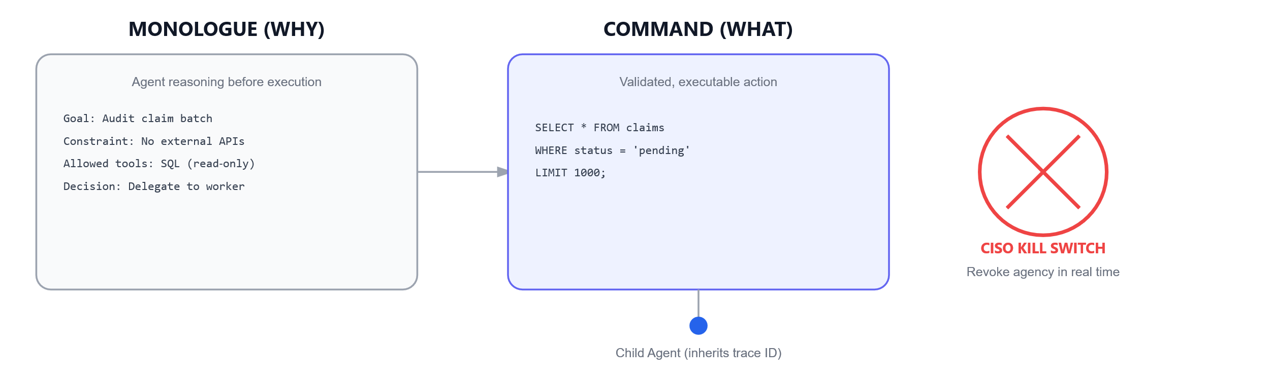
Flight Recorder: From Reasoning to Action
The “Flight Recorder” captures the agent’s internal monologue and resulting command, 100% forensic accountability.
Immutable lineage: parent → child delegation with a global trace ID.
Prevents “ghost actions” outside original user intent.
CISO kill switch: real‑time visibility into agency perimeters + revoke instantly.

Slide 8
Architecture Is the Moat
Reveila uses a Metadata-Driven Proxy Architecture. Every agentic tool is wrapped in a governance proxy that manages its own isolated class loader and physical sandbox. We don't just run code; we orchestrate a fleet of isolated micro-runtimes.
Manager Agent
REVEILA CORE
Orchestration • Policy • Lineage
INTELLIGENCE
Models / Reasoning
EXECUTION
Systems / Tools
Worker Agent
Notes:
The core is stable. Models and systems change at the edges. Governance survives change.
Intelligence and execution are decoupled
Change happens at the edges, not the core
Governance survives model swaps, tools swaps, and org changes
A stable core protected by governance
Ports & adapters instead of tight coupling
Manager → Worker delegation inside the perimeter
Models and systems are replaceable, not foundational

Slide 9
Beyond the Code
This system doesn’t break when models change - because intelligence and execution were never coupled.
Built on hexagonal architecture + metadata‑driven boundaries.
Decouples intelligence from execution so systems can evolve safely.
Change‑resilient fabric designed for high‑reg verticals.
Manager‑Worker orchestration enables delegation without losing the security perimeter.
Notes:
The core is stable. Models and systems change at the edges. Governance survives change.
Intelligence and execution are decoupled
Change happens at the edges, not the core
Governance survives model swaps, tools swaps, and org changes
A stable core protected by governance
Ports & adapters instead of tight coupling
Manager → Worker delegation inside the perimeter
Models and systems are replaceable, not foundational

Slide 10
Instant Sovereignty: The Multi‑Agent Kill Switch
For the first time, the CISO doesn’t monitor AI — the CISO commands it.
Notes:
Instant Isolation Revoking a perimeter does not stop a thread — it instantly destroys the Docker sandbox executing that agent’s action. No persistence. No lateral movement. Zero data leakage by design. [Reveila -...ime Fabric | PowerPoint]
Forensic Sync Every revoked action is immediately flagged inside the Flight Recorder, preserving full lineage from reasoning → action → termination. The post‑mortem is automatic, immutable, and audit‑ready. [Reveila -...ime Fabric | PowerPoint]
Agnostic Enforcement This dashboard governs all agents equally, regardless of which model is reasoning above the line — OpenAI, Gemini, or Claude. Models may change. Control does not.

Slide 11
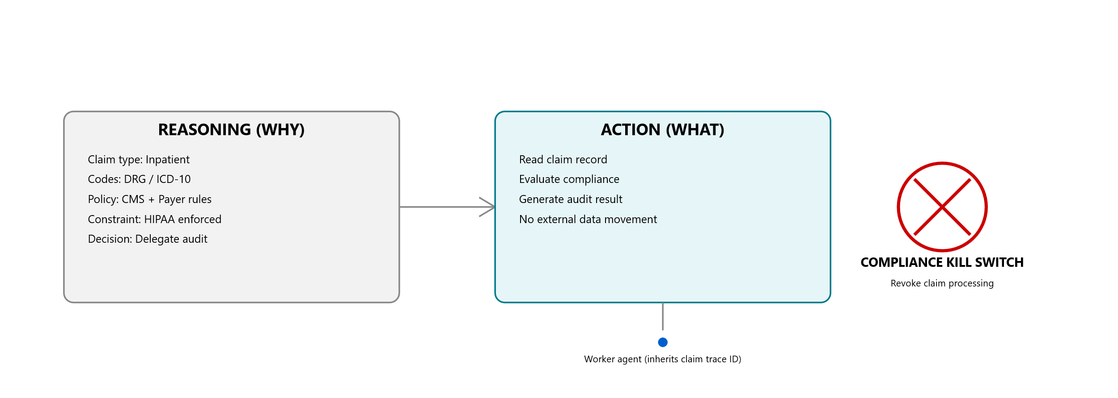
Case Study 1:
Claims Lineage & Forensic Accountability
Healthcare has millions of claims to audit; standard AI is too risky for execution.
HIPAA risk makes uncontrolled agent execution unacceptable.
Reveila enables a “Claims Fabric”:
Guarded execution inside isolated sandboxes
Dual‑audit shield to prevent unsafe intent/actions
Flight Recorder for audit‑ready forensic trails
Result: safer automation at scale where mistakes carry regulatory consequences.
Every claim decision is traceable from clinical reasoning to execution — and stoppable in real time.
Notes:
Claims Lineage & Forensic Accountability
Why a claim decision was made (clinical / coding reasoning)
How that reasoning turned into an action
Where every delegated step came from
Who can stop it in real time (compliance / CISO)
Show me how you prove this decision was safe.
Uses claims language, not generic “tasks”
Explicitly shows HIPAA constraint enforcement
Emphasizes audit outcome, not automation speed
Makes lineage concrete at the claim level
Frames the kill switch as compliance control, not engineering

Slide 12
Case Study 2:
Solving the $100M "Trust Gap" in M&A
The Scenario:
A private equity firm needs to analyze 10,000 sensitive financial documents using AI agents.
An agent might "hallucinate" a data exfiltration call or mix tenant data, leaking trade secrets between the buyer and the target.
The Reveila Solution:
Manager Agent: Orchestrates the audit.
Finance Workers: Run in Docker-isolated sandboxes with zero outbound network access (Perimeter Enforcement).
The Flight Recorder: Provides the PE firm's legal team with a 100% forensic trace of how every financial conclusion was reached.

Slide 13
Core Capabilities
Guarded Runtime (Secure Core)
Universal Discovery & Invocation
Agency Perimeters (Governance)
The Flight Recorder (Observability)
The Agentic Fabric & Orchestration
Multi‑tenant sovereignty (true tenant isolation at infrastructure level)
Agentic Connector SDK (wrap legacy systems into compliant plugins faster)
CISO Command Center (pause/rewind/stop actions)

Slide 14
Business Model — Value-Aligned Pricing
Infrastructure Subscription (The Baseline)
Target: Enterprise Platform Teams.
Model: Tiered annual subscription based on the number of Sovereign Nodes (isolated clusters) managed.
Value: Provides the core "Agentic Fabric" and "Guarded Runtime" orchestration.

Slide 15
Business Model — Value-Aligned Pricing
Managed Tool Invocations (The Growth Engine)
Target: Business Units (M&A, Healthcare Ops).
Model: Usage-based fee per "Validated Execution."
Value: You charge for the security processing power. Every time the Universal Invocation Bridge intercepts a call, validates the schema, and enforces a perimeter, Reveila captures a fractional fee.

Slide 16
Business Model — Value-Aligned Pricing
Forensic Storage & Compliance (The Retention Layer)
Target: CISO / Legal / Compliance Departments.
Model: Fee based on "Flight Recorder" data retention and audit-ready reporting.
Value: High-margin revenue for providing immutable evidence of AI reasoning for regulatory requirements.

Slide 17

The Team — Architecting the Future
Built by Enterprise Architects for Enterprise Reality.
Charles Lee, Founder & Chief Architect, is an Enterprise Architect who has spent decades managing $200M+ digital transformations for Fortune 100 firms.
Charles is a Fractional CTO who has deep understanding of system integration, M&A complexity, and high-performance Java/Spring ecosystems.

Slide 18

Multi-Model Governance Fabric
Reveila is the first Agentic Control Plane that treats AI like a privileged human employee.
We use Filo to proactively surface intent, ChatGPT to reason, Gemini to audit, and Docker to physically contain the execution. We don't just 'monitor' AI; we govern it at the hardware level.

Slide 19
Operational Performance
Core Governance Latency: (e.g., 12ms) — The internal metadata-driven proxy logic is nearly instantaneous
Isolated Execution Latency: (e.g., 1,200ms) —"Security Tax“ for the Docker-based physical isolation
Audit Trail Overhead: (e.g., 45ms) —Flight Recorder persists reasoning logs without stalling the agent

Slide 20
The Overwatch Security Layer
The Cryptographic Handshake: We will introduce a com.reveila.ai.SecurityFabric component within the core engine. This component generates a unique OversightSession when a CISO authenticates.
Zero-Trust Dashboard: The ciso-dashboard.js (now in the interfaces/ folder) will be updated to store this token in a secure, short-lived session.
The Guardrail: Every "Kill Switch" or "Monologue Review" request sent through the UniversalInvocationBridge will require this token. If the token is missing or expired, the bridge will automatically trigger a SYSTEM_LOCKDOWN state, pausing all active agents until a human re-authorizes the fabric.

Slide 21


Questions?
Charles Lee
charles.lee@reveila.com
Links
https://www.linkedin.com/in/cclee
https://github.com/cc2lee/Reveila

Slide 22
It’s no surprise Marcos uses Google Translate in his shop regularly.
There are 23 officially recognized languages in the EU.
Tip
Don’t let data stand alone. Always relate it back to a story you’ve already told, in this case, Marco’s shop.
Source: theguardian.com

Slide 23
Milestones
Mar 2026
Feb 2027
Dec 2026
Dec 2027
TBD
TBD
2026 |  |  |  | 2027
TBD
TBD

Slide 24
What people are saying
With this app, I’m confident to plan a trip to rural Vietnam
Wendy Writer, CA
Visual translation feels like magic
Ronny Reader, NYC
Translate has officially inspired me to learn French
Abby Author, NYC
Quotes for illustration purposes only

